Slide 1
The Team:
Santhana Krishnan
Venkata Pavan Chaitanya
Mythri Gopaluni
Gopika Gopi Krishnan Sheeja
Shiva S Vaidyanathan
Yelp - a powerhouse of reviews

Slide 2
Contents
Introduction
Schema Designs
Data Preparation
Database Overview
Data Analytics
Webpage Design
Challenges
Conclusion

Slide 3
Introduction-Some facts about Yelp
A social networking site that has become the go-to source for customers searching for local businesses ranging from restaurants to mechanics to salons.
Every month there are 139 million unique visitors to Yelp, where they have left more than 67 million reviews.
Do you think the largest category on Yelp is Restaurants??
No,you are wrong.
Shopping/retail represents 23 percent of the reviewed businesses on Yelp. Restaurants are now 19 percent and home local services is the third largest now with 12 percent.
Majority of Yelpers Are Female; What Else Do We Know About Yelpers?

Slide 4
Schema Designs
We had designed two schemas for both Mongo dB and Neo4j which lays a good ground for the query building and data analysis .
Mongo dB Schema
We first created indexes and constraints for the collection.
Then we designed a pseudo-schema for MongoDB.
First, we created a Yelp business main document with photo sub-document inside it.
Then we created Yelp Users document and then Yelp Review sub-document and then finally ended with tip sub document.

Slide 5
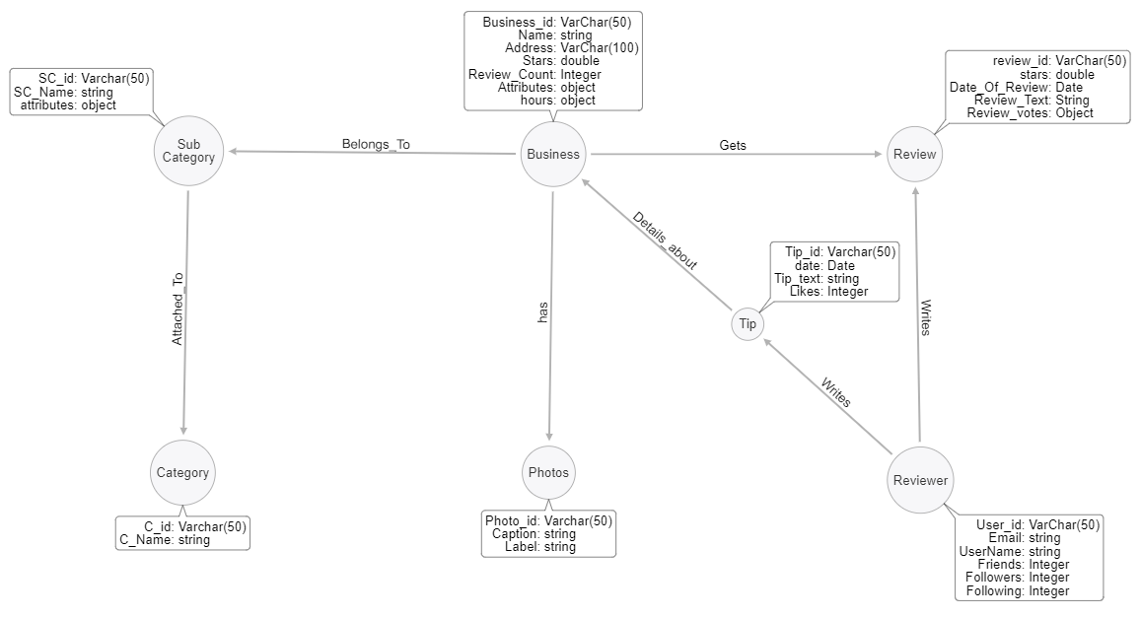
Neo4j Schema

Slide 6

Data Preparation
The original datasets consisted of 5 different collections that includes business,review,user,tips and photos.
For the ease of doing the analysis and due to the constraints with memory management we restricted our analysis to 2 cities in US: Cleveland and Belmont.

Slide 7
Database Overview
An overall overview of the dataset will help in a better understanding of the different fields and its values for each dataset and the volume of information hidden in each dataset.
Overview of Business database:
Categorising into different services.
overall number of businesses in Cleveland and Belmont.
the top 10 categories with the highest number of reviews
Location of top 10 Restaurants with the highest number of reviews

Slide 8
Database Overview
Overview of Reviewer database:
the overall number of reviewers per business.
Overall count of reviewers.
the top 10 most verbose reviewers.

Slide 9
Database Overview
Overview of Review database:
overall number of reviews per business .
the overall number of reviews with ratings more than 3
the overall number of reviews with ratings less than or equal 3
the average number of reviews per business
the date of the first review per category per business ID.

Slide 10
Data Analytics
Metrics:
1.Cuisine wise categorisation of restaurants:Mexican,Chinese,American,steakhouse,coffee
2. Review Histogram per reviewer
3.Latest Review of the reviewer
4. Latest Review per business
5. Restaurants which allows pet dogs and that have Wheel chair accessibility
6. Review Histogram per business_id
7. Prolific reviewers

Slide 11
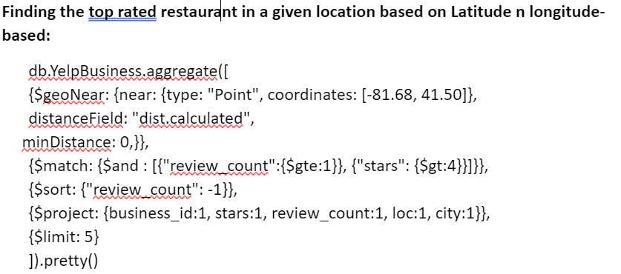
3. Top restaurants around a person based on his current location

Slide 12
Data Analytics
Text and non-text-based analysis for helpfulness of the review
Text based-Criteria for helpfulness we created is to
search for general words such as "experience,ambience,service,excellent,price range" which elevates the usefulness of reviews.
String length>300 which denotes the text length.
2. Non-text based-
Our criteria was to find the sum of cool and useful votes for each review and sorted it in the descending order.

Slide 13
Data Analytics
Neo4j
Data Preparation:
Part a: Joined review and business datasets and performed some ETL operations using Tableau Prep to extract data on Belmont city with category Restaurants only.
Part b: divided the datasets for 3 different years:2015,2016,2017 for doing the analysis on geographic proximity.

Slide 14

Data Analytics
Neo4j
Reviewers who reviewed as a mob-
Through the analysis we found that there is a tendency for the people to review as a mob. There are common set of businesses reviewed by a common set of people.
This can imply the common interests of people with similar preferences .

Slide 15
Data Analytics
Neo4j
Correlation between geographical proximity of a business and the business ratings
Analysed the average of total ratings for each business id for 3 years in the city of Belmont.
Wendy’s shows the highest average rating for each of the years and it shows a consistence performance over the years .
Due to the incomplete data for the year 2018 ,the graph do not fully represent the exact number for 2018.
Insight: The change in average rating followed a trend which is uniform with respect to time .

Slide 16
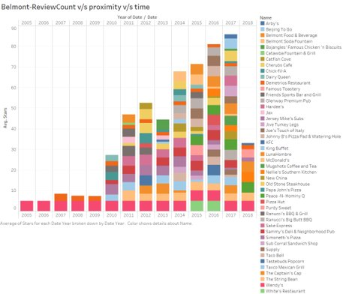
Visualization

Slide 17
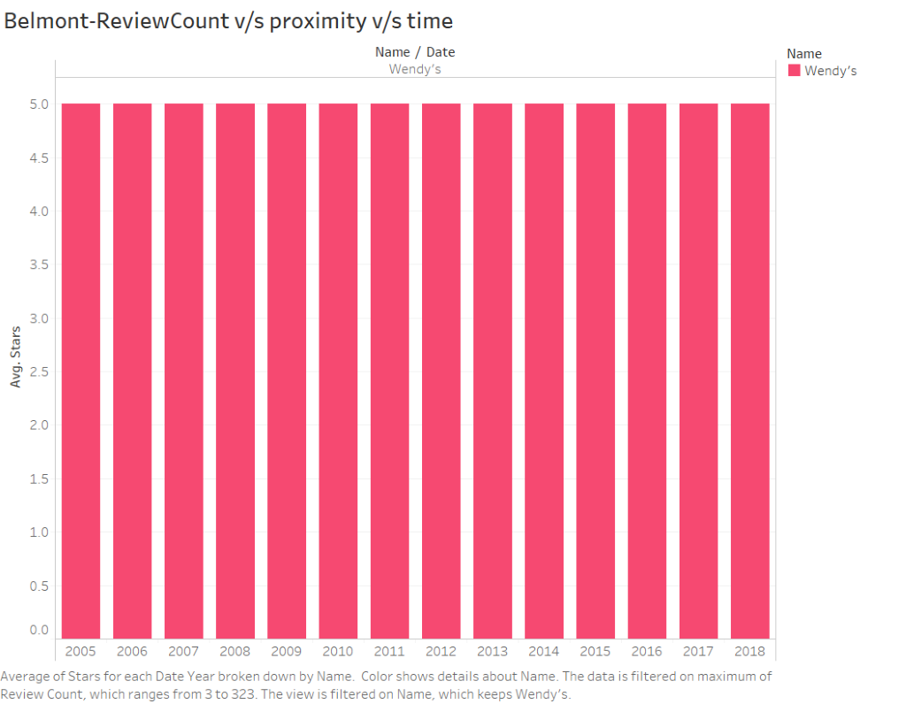

Slide 18
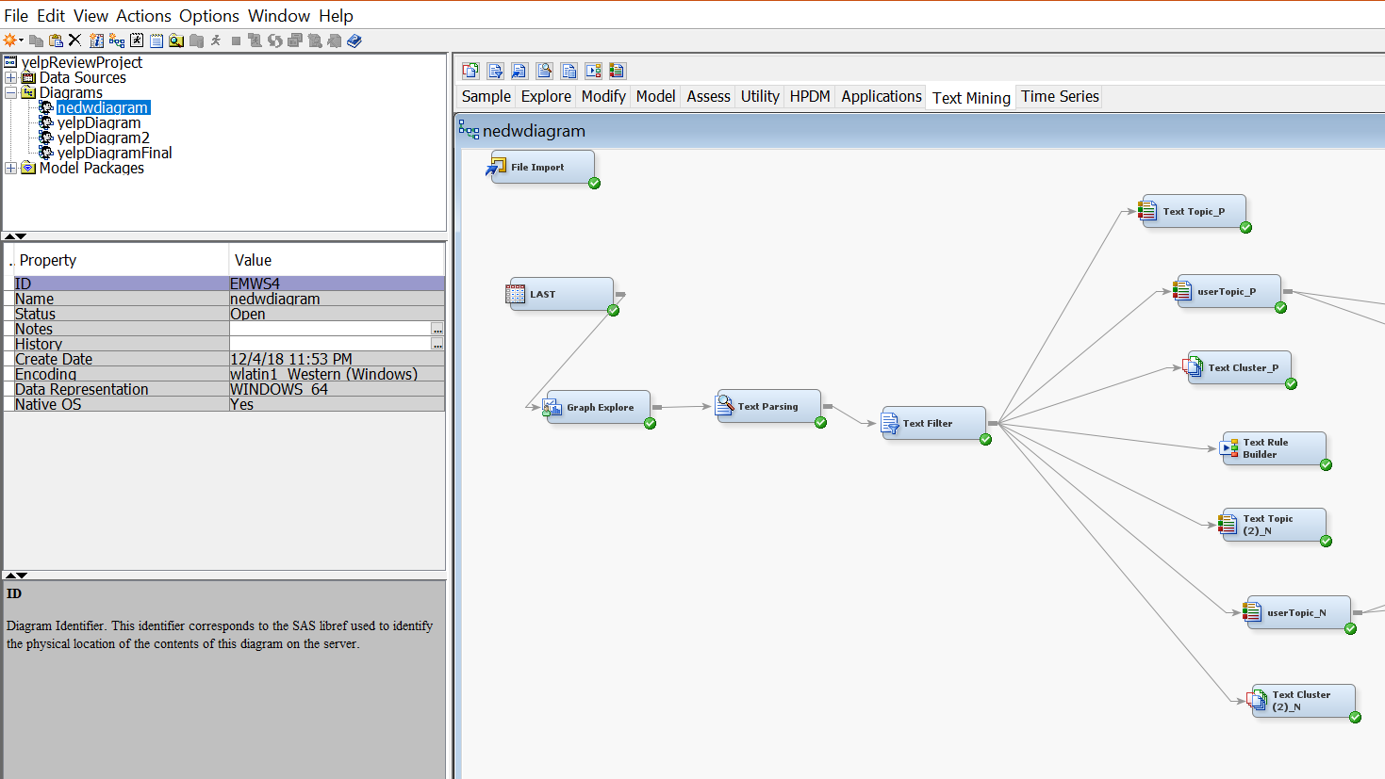
Fake Reviews Investigation

Slide 19
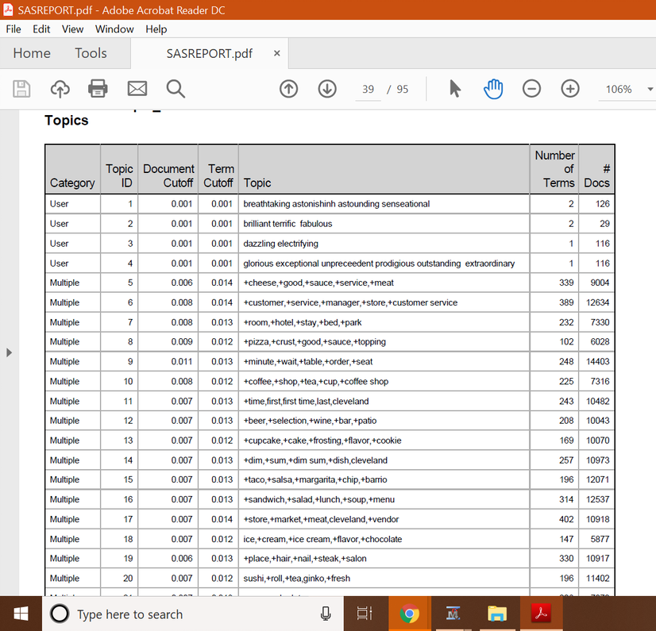
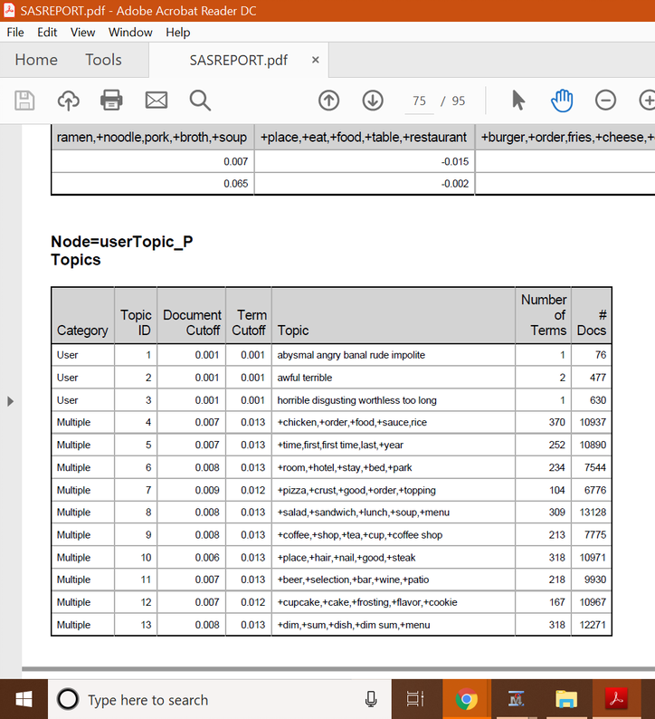
Results

Slide 20

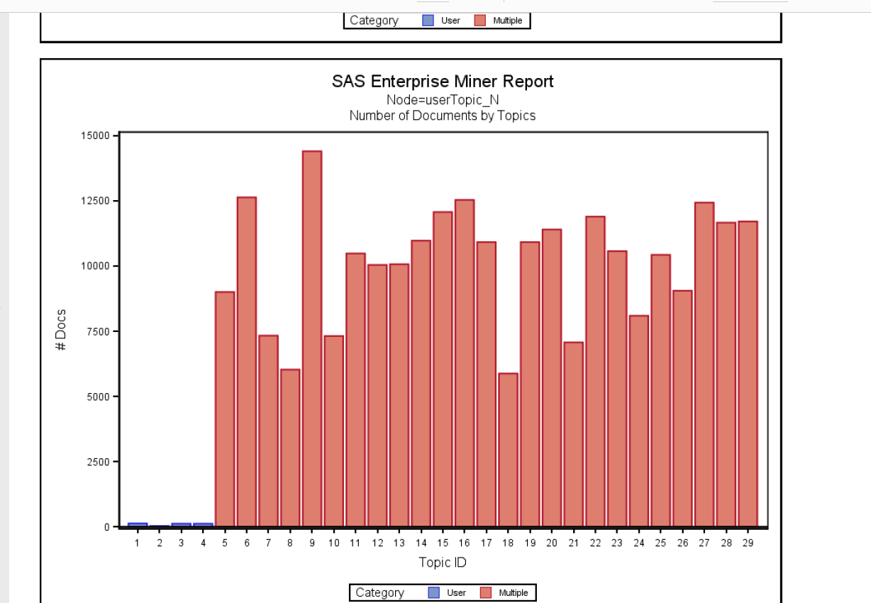
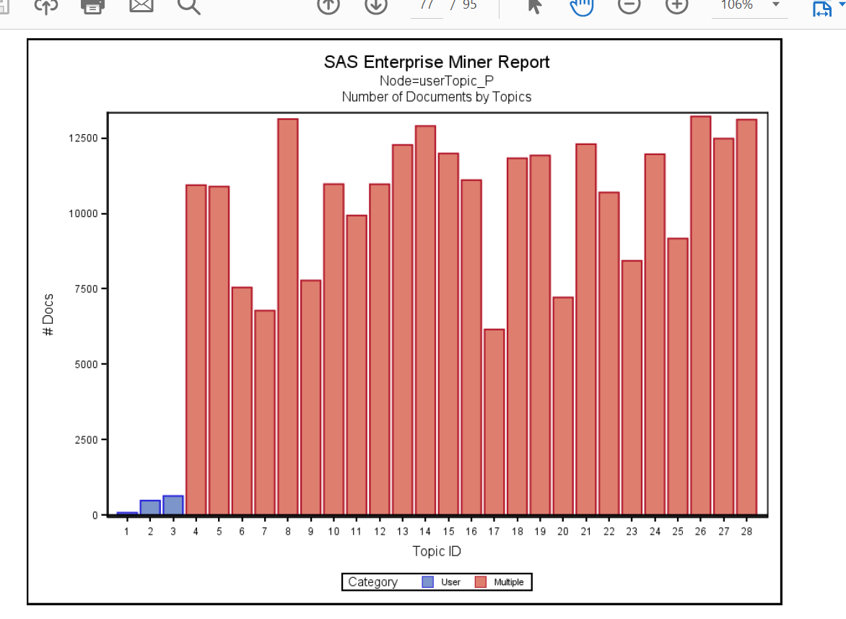
SAS Reports

Slide 21
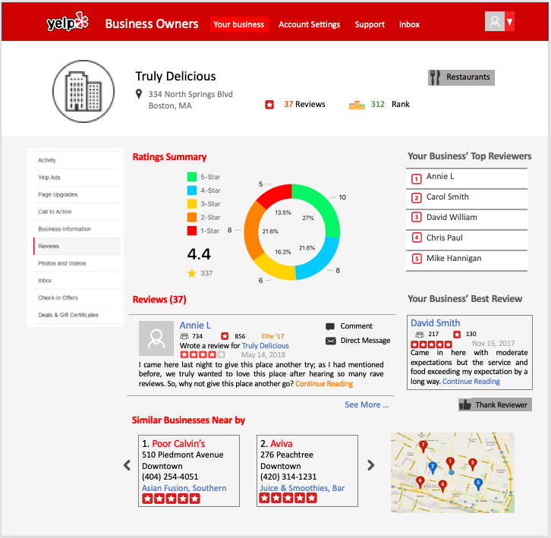

Slide 22
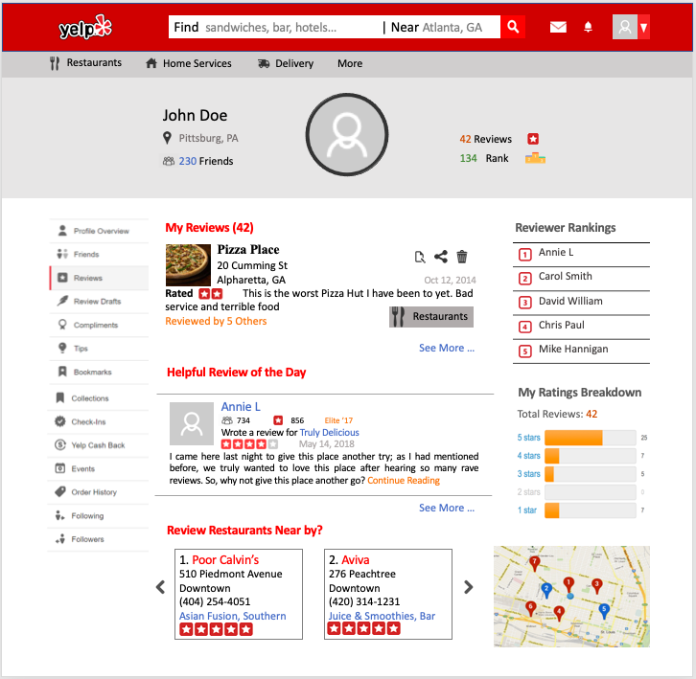

Slide 23
Thank You

